Slide 1
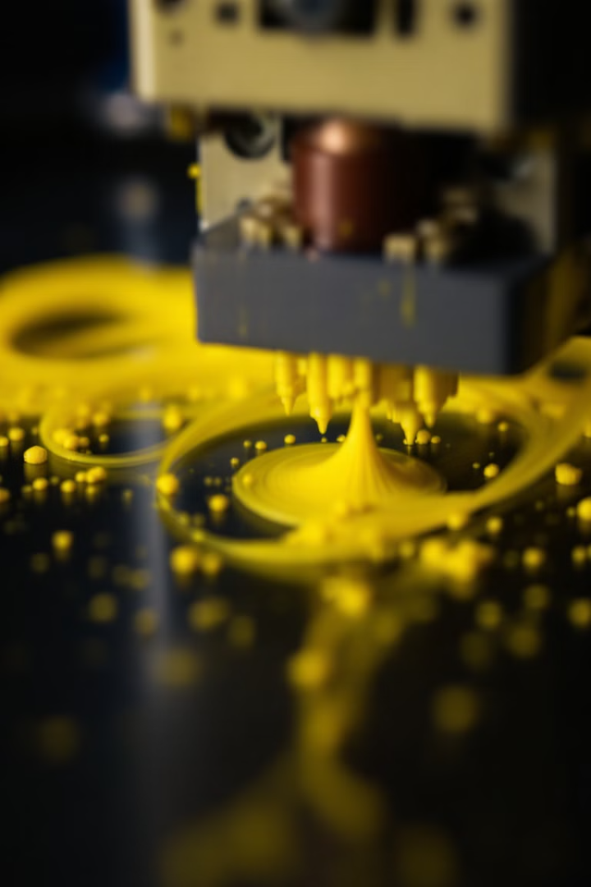
3D Printer Error Detection: Nozzle Extrusion Classification
Welcome to our project report on 3D Printer Error Detection, focusing on nozzle extrusion classification. This presentation will cover our objectives, dataset analysis, data preprocessing, modeling approach, and results. Our team aims to build a model that can predict nozzle extrusion occurrences in 3D printing to prevent errors and minimize waste.

Slide 2

Project Objectives and Dataset
Purpose
Goal
Predict nozzle extrusion occurrences in 3D printing to prevent errors
Build a model to classify nozzle images using the Residual Attention Model
Outcome
Dataset
Provide actionable insights for 3D printing systems to minimize waste and errors
Kaggle competition dataset with labeled images of 3D printer nozzles

Slide 3
Data Understanding and Exploration
Dataset Overview
Feature Description
The dataset is designed for binary classification of nozzle images into extrusion or no extrusion. It contains 81,060 training images and 25,279 test images.
Input: Image data from nozzle cameras Target Variable: has_under_extrusion Other features: img_path, printer_id

Slide 4
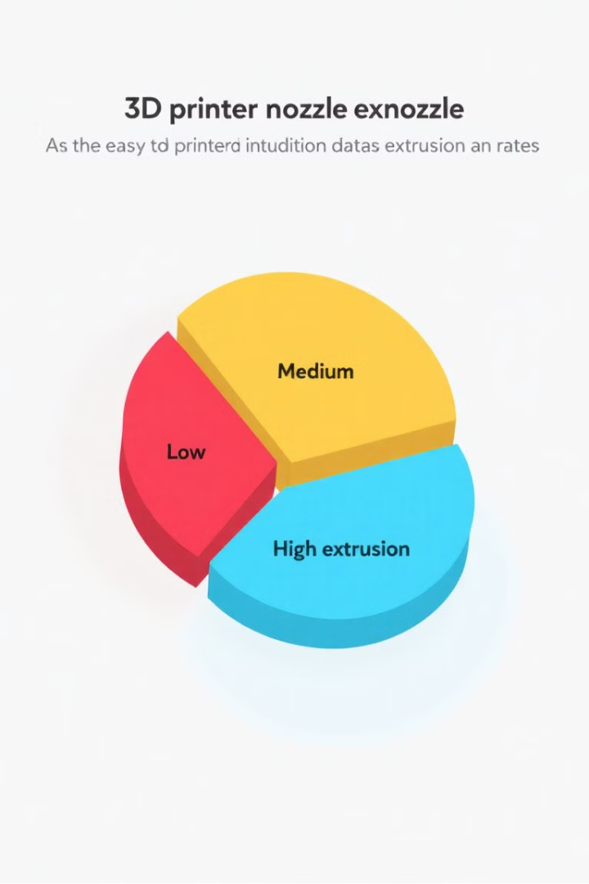
Data Distribution and Quality
54.7%
Extrusion Occurred
Percentage of images labeled as having extrusion
45.3%
No Extrusion
Percentage of images labeled as not having extrusion
0
Missing Values
No missing values or duplicates were observed in the dataset

Slide 5

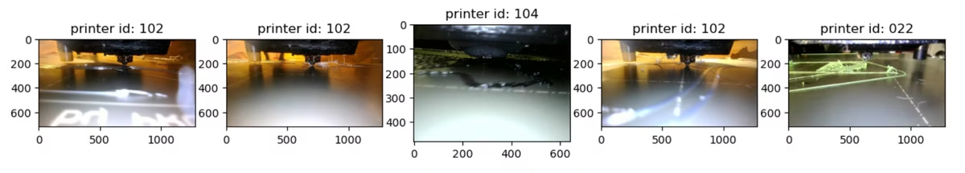
Data Visualization
Visualizing sample nozzle images helps in understanding data patterns and validating dataset content. Here are examples of images with under extrusion:

Slide 6


Data Preprocessing
1
Handling Missing Data
No missing data to handle, simplifying preprocessing steps.
2
Encoding Categorical Variables
Labels were encoded as integers (0 and 1) for model training.
3
Feature Scaling
Images were normalized to a [0,1] range for uniformity, improving model convergence.

Slide 7

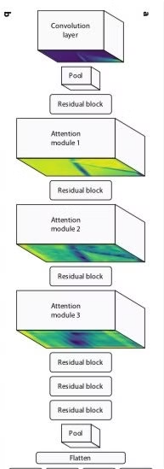

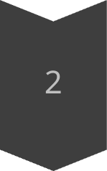
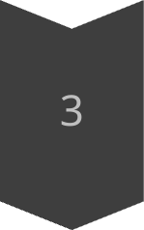
Modeling Approach
Algorithm Selection
ARCNN with attention modules for focused feature extraction
Data Splitting
Train/Test split: 80/20 for robust evaluation
Model Training
Hyperparameters: Learning rate 0.0001, Batch size 32, Epochs 11

Slide 8

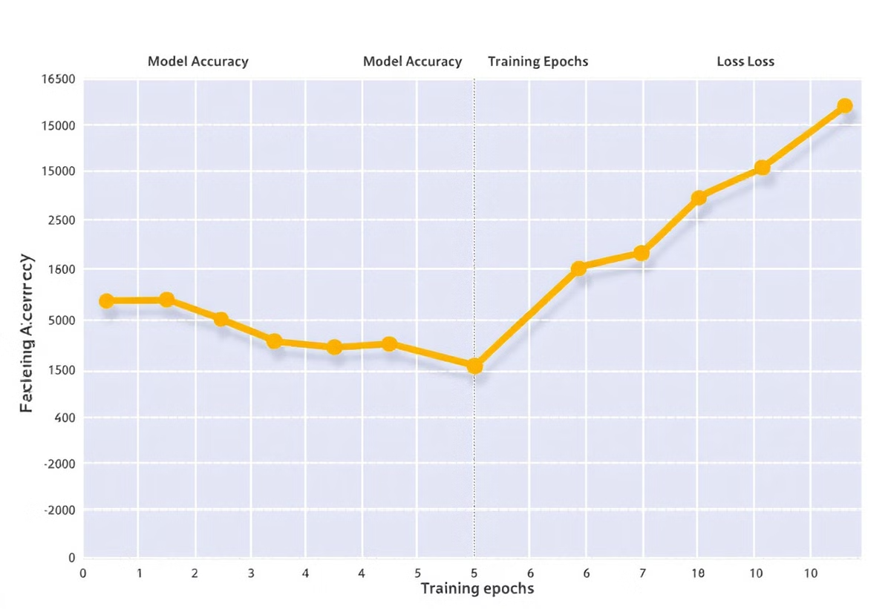
Model Evaluation and Improvement
Evaluation Metrics
Performance Analysis
Accuracy and loss were used to assess model performance
The model showed consistent improvement in training loss over epochs
Improvement Techniques
Data augmentation and learning rate scheduling were applied to enhance generalization

Slide 9
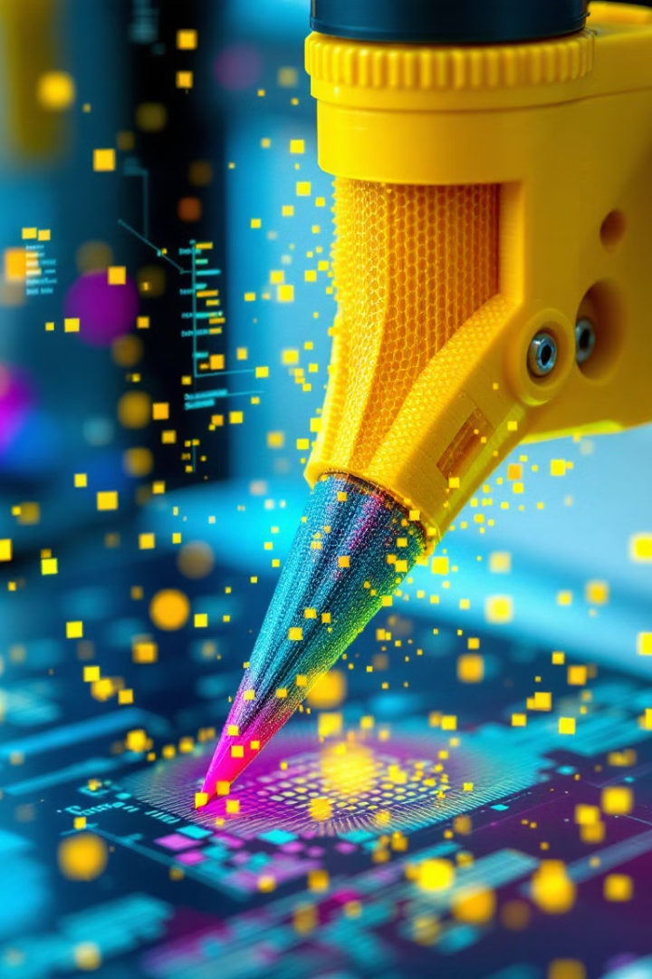
Final Model Selection and Results
The ARCNN Model was chosen as the final model due to its superior performance in classifying nozzle images. It demonstrated robust training results and a consistent decrease in loss, indicating its effectiveness in identifying extrusion occurrences in 3D printing operations.

Slide 10



Conclusion and Future Work
Successful Classification
1
ARCNN Model effectively classified nozzle images
Future Improvements
2
Experiment with Vision Transformers and hyperparameter tuning
Enhanced Accuracy
3
Integrate ensemble methods for improved classification
Our project demonstrates the potential for AI in improving 3D printing processes, paving the way for more efficient and error-free manufacturing.

